Slide 1
Computer Architecture
Arithmetic for Computer

Slide 2
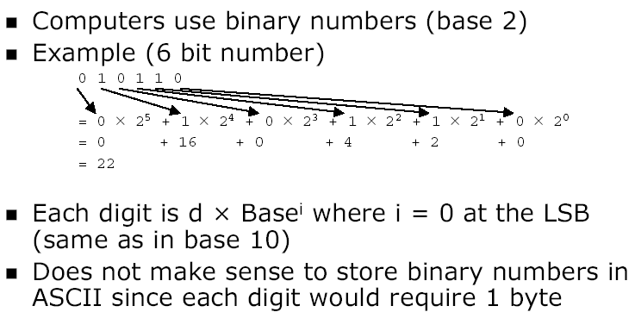
Positive Binary Numbers
Notes:
credential:
bring a computer
die photo
wafer
:
This can be an hidden slide. I just want to use this to do my own planning.
I have rearranged Culler’s lecture slides slightly and add more slides. This covers everything he covers in his first lecture (and more) but may
We will save the fun part, “ Levels of Organization,” at the end (so student can stay awake): I will show the internal stricture of the SS10/20.
Notes to Patterson: You may want to edit the slides in your section or add extra slides to taylor your needs.

Slide 3
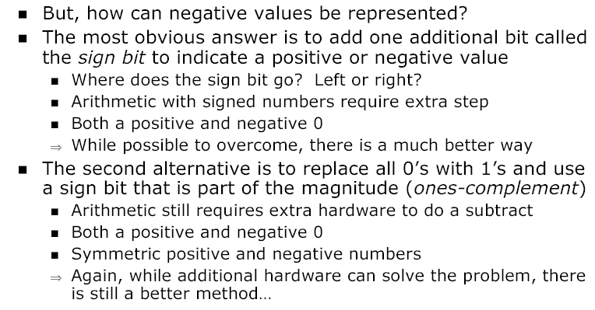
Negative Numbers
Notes:
credential:
bring a computer
die photo
wafer
:
This can be an hidden slide. I just want to use this to do my own planning.
I have rearranged Culler’s lecture slides slightly and add more slides. This covers everything he covers in his first lecture (and more) but may
We will save the fun part, “ Levels of Organization,” at the end (so student can stay awake): I will show the internal stricture of the SS10/20.
Notes to Patterson: You may want to edit the slides in your section or add extra slides to taylor your needs.

Slide 4
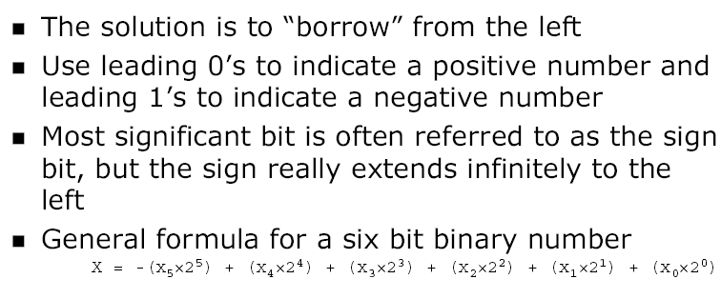
2’s Complement
Notes:
credential:
bring a computer
die photo
wafer
:
This can be an hidden slide. I just want to use this to do my own planning.
I have rearranged Culler’s lecture slides slightly and add more slides. This covers everything he covers in his first lecture (and more) but may
We will save the fun part, “ Levels of Organization,” at the end (so student can stay awake): I will show the internal stricture of the SS10/20.
Notes to Patterson: You may want to edit the slides in your section or add extra slides to taylor your needs.

Slide 5
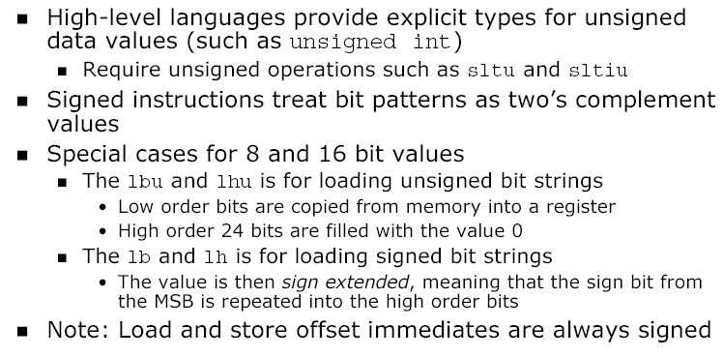
Signed Operations
Notes:
credential:
bring a computer
die photo
wafer
:
This can be an hidden slide. I just want to use this to do my own planning.
I have rearranged Culler’s lecture slides slightly and add more slides. This covers everything he covers in his first lecture (and more) but may
We will save the fun part, “ Levels of Organization,” at the end (so student can stay awake): I will show the internal stricture of the SS10/20.
Notes to Patterson: You may want to edit the slides in your section or add extra slides to taylor your needs.

Slide 6
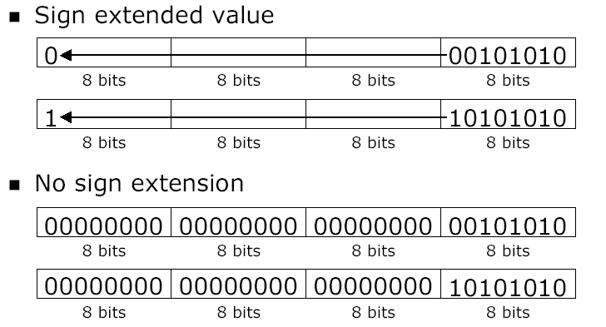
Signed Extension
Notes:
credential:
bring a computer
die photo
wafer
:
This can be an hidden slide. I just want to use this to do my own planning.
I have rearranged Culler’s lecture slides slightly and add more slides. This covers everything he covers in his first lecture (and more) but may
We will save the fun part, “ Levels of Organization,” at the end (so student can stay awake): I will show the internal stricture of the SS10/20.
Notes to Patterson: You may want to edit the slides in your section or add extra slides to taylor your needs.

Slide 7
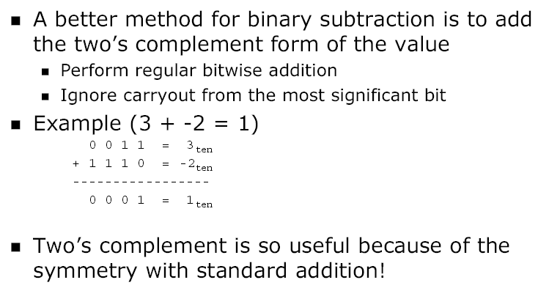
Binary Subtraction
Notes:
credential:
bring a computer
die photo
wafer
:
This can be an hidden slide. I just want to use this to do my own planning.
I have rearranged Culler’s lecture slides slightly and add more slides. This covers everything he covers in his first lecture (and more) but may
We will save the fun part, “ Levels of Organization,” at the end (so student can stay awake): I will show the internal stricture of the SS10/20.
Notes to Patterson: You may want to edit the slides in your section or add extra slides to taylor your needs.

Slide 8
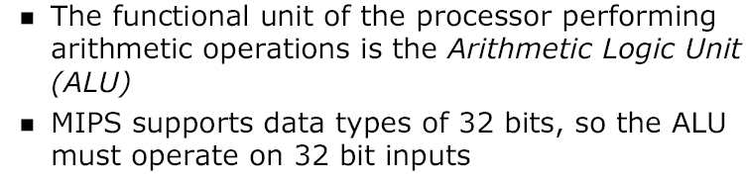
Arithmetic Logic Unit (ALU)
Notes:
credential:
bring a computer
die photo
wafer
:
This can be an hidden slide. I just want to use this to do my own planning.
I have rearranged Culler’s lecture slides slightly and add more slides. This covers everything he covers in his first lecture (and more) but may
We will save the fun part, “ Levels of Organization,” at the end (so student can stay awake): I will show the internal stricture of the SS10/20.
Notes to Patterson: You may want to edit the slides in your section or add extra slides to taylor your needs.

Slide 9
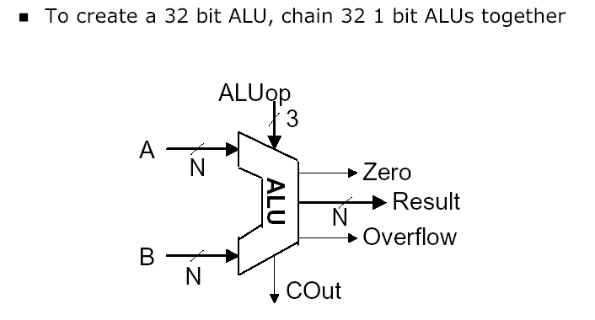
N-bit ALU
Notes:
credential:
bring a computer
die photo
wafer
:
This can be an hidden slide. I just want to use this to do my own planning.
I have rearranged Culler’s lecture slides slightly and add more slides. This covers everything he covers in his first lecture (and more) but may
We will save the fun part, “ Levels of Organization,” at the end (so student can stay awake): I will show the internal stricture of the SS10/20.
Notes to Patterson: You may want to edit the slides in your section or add extra slides to taylor your needs.

Slide 10
Logic operations
Sometimes operations on individual bits needed:
Logic operation C operation MIPS instruction
Shift left logical << sll
Shift right logical >> srl
Bit-by-bit AND & and, andi
Bit-by-bit OR | or, ori
and and andi can be used to turn off some bits; or and ori turn on certain bits
Of course, AND en OR can be used for logic operations.
Note: Language C’s logical AND (&&) and OR (||) are conditional
andi and ori perform no sign extension !

Slide 11
An ALU (arithmetic logic unit)
Let's build an ALU to support the andi and ori instructions
we'll just build a 1 bit ALU, and use 32 of them
operation
a
result
b

Slide 12
Review: The Multiplexor
Selects one of the inputs to be the output, based on a control input
Lets build our ALU and use a MUX to select the outcome for the chosen operation
S
note: we call this a 2-input mux
even though it has 3 inputs!
A
0
C
B
1

Slide 13
Different Implementations
Not easy to decide the “best” way to build something
Don't want too many inputs to a single gate
Don’t want to have to go through too many gates
For our purposes, ease of comprehension is important
Let's look at a 1-bit ALU for addition (= full-adder):
CarryIn
c_{out} = a b + a c_{in} + b c_{in}
sum = a xor b xor c_{in}
a
+
Sum
b
CarryOut
How could we build a 1-bit ALU for add, and, and or?
How could we build a 32-bit ALU?

Slide 14
Building a 32 bit ALU

Slide 15
What about subtraction (a – b) ?
Two's complement approach: just negate b and add
How do we negate?
A very clever solution:

Slide 16
Tailoring the ALU to the MIPS
Need to support the set-on-less-than instruction (slt)
remember: slt rd,rs,rt is an arithmetic instruction
produces a 1 if rs < rt and 0 otherwise
use subtraction: (a-b) < 0 implies a < b
Need to support test for equality
beq $t5, $t6, label
jump to label if $t5 = $t6
use subtraction: (a-b) = 0 implies a = b

Slide 17
Supporting 'slt'
Can we figure out the idea? (fig. 4.17 2nd ed.)
bits 0-30
bit 31

Slide 18
Overflow in two’s complement addition
Definition: When two values of the same signs are added:
Result won’t fit in the number of bits provided
Result has the opposite sign.
Overflow?
C_{N}
C_{N-1}
Assumes an N-bit adder, with bit N-1 the MSB

Slide 19
Addition cases and overflow
00
0010
0011
--------
0101
01
0011
0110
--------
1001
11
1110
1101
--------
1011
10
1101
1010
--------
0111
00
0010
1100
--------
1110
11
1110
0100
--------
0010
2
3
5
3
6
-7
-2
-3
-5
-3
-6
7
2
-4
-2
-2
4
2
OFL
OFL

Slide 20
Supporting the ‘slt’ operation

Slide 21
Test for equality
a-b = 0 ⇔a=b
Notice control lines: 000 = and 001 = or 010 = add 110 = subtract 111 = slt
Note: signal Zero is a 1 when the result is zero!
The Zero output is always calculated

Slide 22
ALU symbol
operation
32
a
zero
ALU
32
result
overflow
32
b
carry-out

Slide 23
Conclusions
We can build an ALU to support the MIPS instruction set
key idea: use multiplexor to select the output we want
we can efficiently perform subtraction using two’s complement
we can replicate a 1-bit ALU to produce a 32-bit ALU
Important points about hardware
all of the gates are always working
not efficient from energy perspective !!
the speed of a gate is affected by the number of connected outputs it has to drive (so-called Fan-Out)
the speed of a circuit is affected by the number of gates in series (on the “critical path” or the “deepest level of logic”)
Unit of measure: FO4 = inverter with Fan-Out of 4
P4 (heavily superpipelined) has about 15 FO4 critical path

Slide 24
Multiplication (0)
More complicated than addition
accomplished via shifting and addition
More time and more area
Let's look at 3 versions based on grade school algorithm 0010 (multiplicand) __*_1011 (multiplier)
Negative numbers: convert and multiply
there are better techniques, we will look at them later

Slide 25
Multiplication (1)
First implementation
Product initialized to 0

Slide 26
Multiplication (2)
Second version

Slide 27
Multiplication (3)
Final version
Product initialized with multiplier

Slide 28
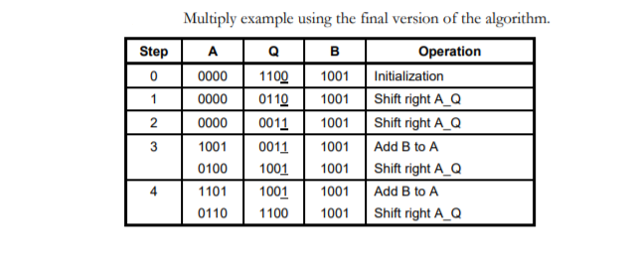
Example 1 Use the Final version of multiplication algorithm to find 9 x 12 = 108 multiplier 12 and multiplicand 9

Slide 29
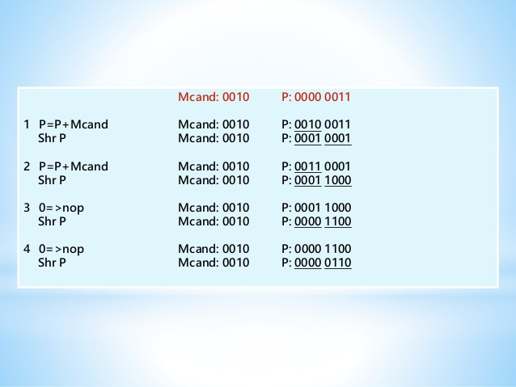
Example 2 Alg. 3 2 * 3 =? Mcand =2 Mtlier = 3 each size is 4 bits

Slide 30
Division (1)
Similar to multiplication: repeated subtract
The book discusses again three versions
We will look at one version
We have divisor( 32) , dividend(64) and quotient (32)
Three registers: The divisor and remainder 64 bits quotient 32 bits
Initially divisor is placed in left half of divisor reg and dividend is placed in remainder registers.
Do steps in next slide and repeat 33 times divisor +1
There are other two algorithms see the book for more details.

Slide 31
Division (2)
Start
1. Substract the Divisor register from the
Remainder register and place the
result in the Remainder register
Implementation:
Repeat 33 times
Divisor is placed in left
half of divisor register
Test Remainder
>= 0
< 0
2.a Shift the Quotient register
to the left, setting the
rightmost bit to 1
2.b Restore the original value by
adding the Divisor register. Also,
shift a 0 into the Quotient register
Divisor
Shift right
Shift Divisor Register right 1 bit
6
4
b
i
t
s
Quotient
33rd repetition?
no
6
4
-
b
i
t
A
L
U
Shift left
3
2
b
i
t
s
Remainder
yes
W
r
i
t
e
C
o
n
t
r
o
l
t
e
s
t
6
4
b
i
t
s
Done

Slide 32
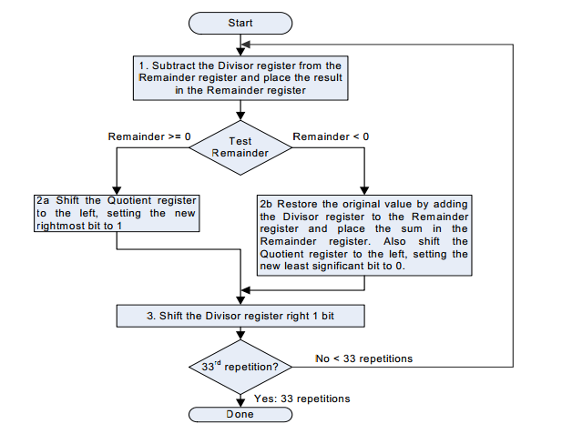

Slide 33
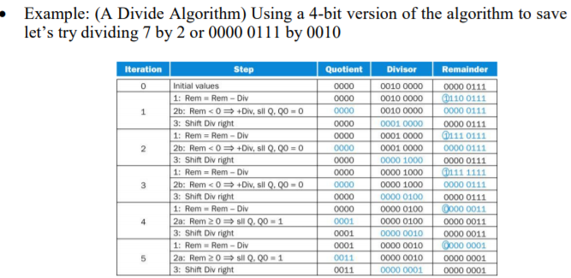
Division example

Slide 34
Modified Booth Recoding algorithm
Booth's algorithm is a multiplication algorithm that multiplies two signed binary numbers in 2's compliment notation.
One advantage of the Booth multiplier is, it reduce the number of partial product. The number of steps is reduced in Half. Can do 8 bit multiplication in 4 steps.
The main disadvantage of Booth multiplier is the complexity of the circuit to generate a partial product bit in the Booth encoding.

Slide 35
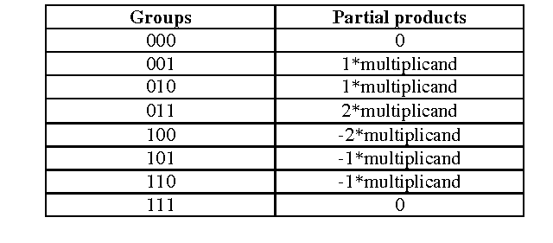
How do we recode the multipiler
Add 0 the right of the multiplier and starting form right group the multiplier into three bit groups and generate a code according to the following table. The last bit in one group will also be the frst bit in the next group. See examples below
Example if multiplier is 9 and assume 5 bits then value is 01001 -> insert 0 right value becomes 0010010 then recoding groups from right are : 010 (1)
100 (-2) and 001 (1). You can insert as many 0 bits to left to the last group the make it three bits.
If multiplier is -9 and assume 5 bits then value is 10111 -> insert 0 right
value 1101110 then recoding groups from right: 110 ( -1), 011 (2) and 110 (-1) You can insert as many 1 to left as needed to the last group to make three bits. In Booth recoding we always find the recoding of the multiplier.

Slide 36
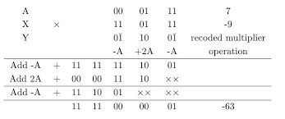
Modified Booth Recoding algorithm example
Assume we want to find 7 x -9. assume 5 bits are used then
7 in binary 0011 and -9 from recoding see last slide is -1, 2, -1 to find the final product we add the following partial products:
-1 x 7 shifted 0 bits to the left,
2 x 7 shifted left 2 bits
-1 x 7 shifted left 4 bits.

Slide 37
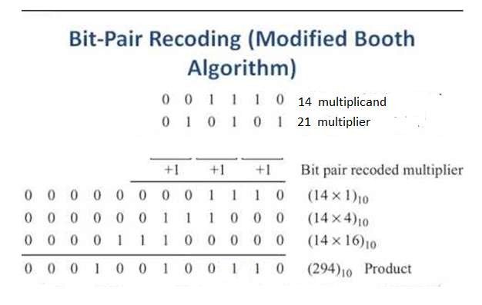
Booth Recoding algorithm; example 2
find 14 x 21 assume 21 multiplier we need 6 bits to represent multiplier 21 signed representation. 21: 010101 three groups
Insert 0 right the groups become 010 (1) 010 (1) 010 (1)
Then we need partial products 01110 shifted 0, 2 and 4 respectively as seen below then add the partial products to get the final value 14 X 21 = 294 More examples found in https://www.youtube.com/watch?v=SGnab30ISwg
https://www.youtube.com/watch?v=FMMHJlLduU

Slide 38
Another example 6 * 6
0110 ‐ multiplicand as base 2 = +6
0110 – multiplier as base 2 = +6
Mutiplier recodeing 01100 groups (011) and (100)
+2 ‐2 – multiplier recoded with Booth’s
product = +2*4 *6 + (‐2) *6
= 111110100 – first partial product = ‐2*(+6) <<0
+ 000110000 ‐ second partial product = +2*(+6)<<2
000100100 – final product = +36
Try - 6 * - 6 get same answer

Slide 39
Another example -6 * 6
1010 ‐ multiplicand as base 2 = -6
1100 – multiplier as base 2 = +6
Mutiplier recodeing 01100 groups (011) and (100)
+2 ‐2 – multiplier recoded with Booth’s
product = +2*4 *-6 + (‐2) *-6
= 00001100 – first partial product = ‐2*(- 6) <<0
+ 11010000 ‐ second partial product = +2*(+6)<<2
11011100 – final product = -36

Slide 40
Summary
Booth recoding add zero right of multiplier group 3 bits and find recoding overlap last bit of a group as the first bit next group.
For each recoding value multiply value with multiplicand and shift result by b bits. 0,2,4..
Add partial products.
Steps half of multiple before
And signed multiplication

